Slide 1
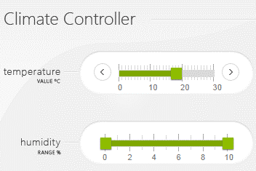
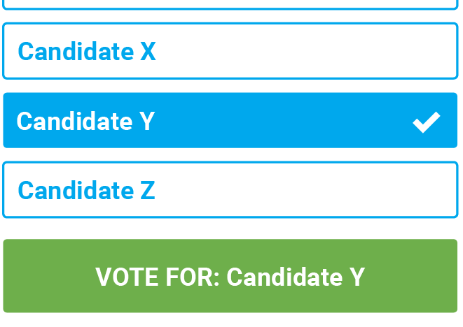

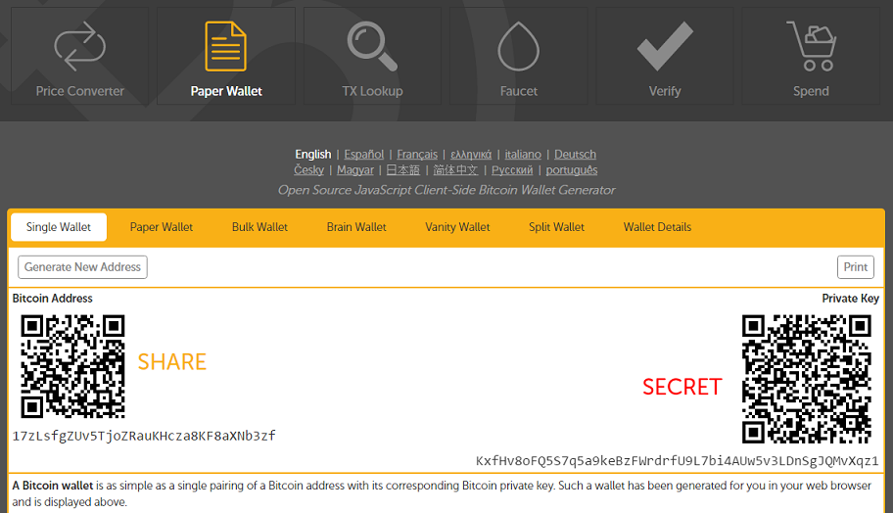
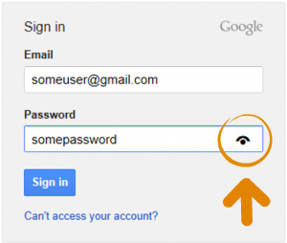
1) Safety-critical systems
2) E-voting
3) Bitcoin wallet
4) Web credential

Slide 2








1
TEE
2
IO driver
User
HIDs
Host
Remote server

Slide 3

1
TEE
2
IO driver
User
HIDs
Host
Remote server

Slide 4





Server
Application level payload
IO second factor
Network
Frames
Input forward
Input
Bridge
Overlay
Host
IO signals

Slide 5
Server
Application level payload
IO second factor
Network
Frames
Input forward
Host
Input
IOHub
Overlay
IO signals

Slide 6





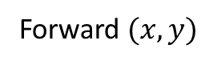
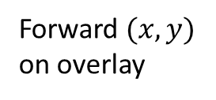
9
Verify
Remote server
7
HTTP data
8
Overlay action
1
Browser render
3
Decode + Overlay
Frame + overlay UI
Send frame
4
2
Forward $(x,y)$
6
Forward $(x,y)$
on overlay
6
Host
Bridge
Display
5
Input

Slide 7

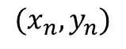
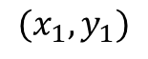
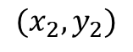
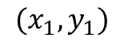
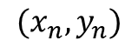
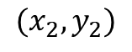
$$(x_{1},y_{1})$$
$$(x_{1},y_{1})$$
$$(x_{2},y_{2})$$
$$(x_{2},y_{2})$$
$$(x_{n},y_{n})$$
$$(x_{n},y_{n})$$
Device side mouse trace
Incoming frames + mouse detection

Slide 8
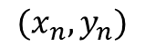
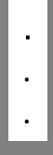
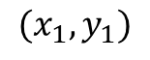
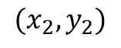
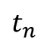

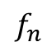
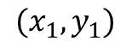
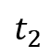
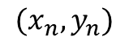
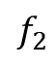
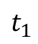
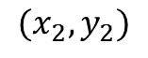
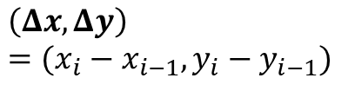
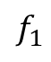
$$t_{1}$$
$$(x_{1},y_{1})$$
$$f_{1}$$
$$(x_{1},y_{1})$$
$$\left(Δx, Δy\right)=(x_{i}−x_{i−1}, y_{i}−y_{i−1})$$
$$t_{2}$$
$$(x_{2},y_{2})$$
$$f_{2}$$
$$(x_{2},y_{2})$$
$$.$$
.
.
$$.$$
.
.
$$t_{n}$$
$$f_{n}$$
$$(x_{n},y_{n})$$
$$(x_{n},y_{n})$$
OK
Click
Click
1
IOHub side mouse trace
2
Incoming frames + mouse detection

Slide 9
Sensitive form
Sensitive field 1
Sensitive field 2
OK
Cancel

Slide 10
Sensitive form
Sensitive field 1
Sensitive field 2
Mouse pointer
UI snapshot
OK
Cancel

Slide 11
Sensitive form
Sensitive form
0
100
0
100
Slider
35
Slider
35
Mouse pointer
UI
UI
Extracted value
Mouse pointer
OK
Cancel
OK
Cancel
1
2

Slide 12
Sensitive form
Sensitive form
0
100
0
100
Slider
35
Slider
35
Mouse pointer
UI snapshot
UI snapshot
Extracted value
Mouse pointer
OK
Cancel
OK
Cancel
1
2

Slide 13
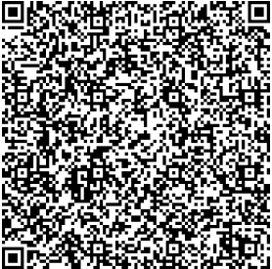
Sensitive form
Sensitive form
Sensitive form
1
2
3
Sensitive field 1
Verified UI from secure_site.io
Sensitive field 1
Data_1
Sensitive field 2
QR code generation
Overlay
Sensitive field 2
Data_2
OK
Cancel
OK
Cancel
Integrity protected
Normal field
Normal field
Normal field
<form action="/some_action“, signature = “0x45AB…”, id = “0x0ab”>
Sensitive field 1: <input type="text" name=“tb_1” protect=“true”><br>
Sensitive field 2: <input type="text" name=“tb_2” protect=“true”><br>
<button type="submit" value="Submit” protect=“true”>Submit</button> <button type="reset" value="Reset” protect=“true”>Reset</button>
Normal field: <input type="text" name=“textbox_3"><br>
</form>
Data to the browser
5
Sensitive field 1:Data_1
Sensitive field 2:Data_2
Action:OK
Sign(payload)
4
Payload

Slide 14

Host
Device
Display
Server
Mouse trace
Frames
Verify
Mouse
Frame + overlay
HTTP request
response
Frames
Frame + overlay
Record inputs + update overlay
Form
Submit data
Send data

Slide 15
Host
IOHub
Display
Server
Mouse trace
Frames
Verify
Mouse
Frame + overlay
HTTP request
response
Frames
Frame + overlay
Form
Record inputs + update overlay
Submit data
Send data

Slide 16
Send encrypted input
2
Encrypt
3
Frame + input overlay
4
ABC
4
Frame
Host
Device
Display
1
Input

Slide 17
Server
1
Webpage + encrypted data
3
Decrypt
2
Frame
Frame + overlay
4
ABC
Host
Device
Display

Slide 18
Text box 1
Text box 2
Option 1
Option 2
Oblivious window
OK
Cancel
Render at host’s side
Server side static image
Text box 1
Text box 2
HTML + overlay on device
Option 1
Option 2
OK
Cancel

Slide 19
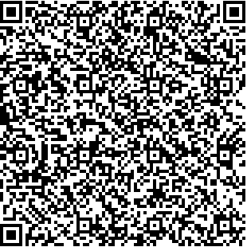
Pointer information to the host
1
Text box 1
Verified UI from secure_site.io
Option 1
Text box 2
Option 2
OK
Cancel
QR code with encrypted UI specification
2
Decoded and Decrypted UI
Render at host’s side + disabled pointer
3
Text box 1
rendered pointer overlaid by the IOHub
Static pointer
Text box 2
Verified UI from secure_site.io
Option 1
Option 2
OK
Cancel
Overlay
HTML + overlay on IOHub + rendered pointer

Slide 20
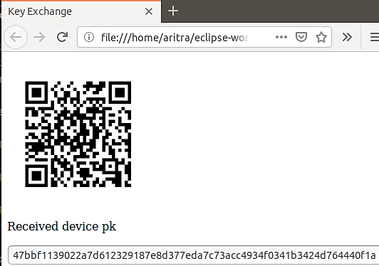
Remote server’s certificate
(Downstream channel)
1
2
IOHub
Certificate of the IOHub
(Upstream channel)
3
4

Slide 21
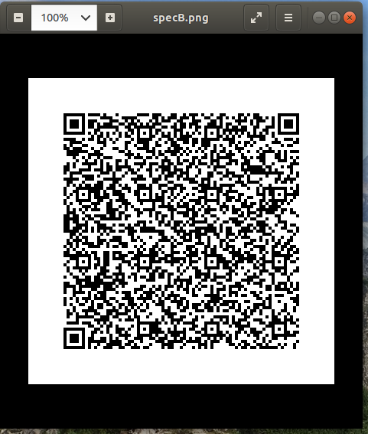
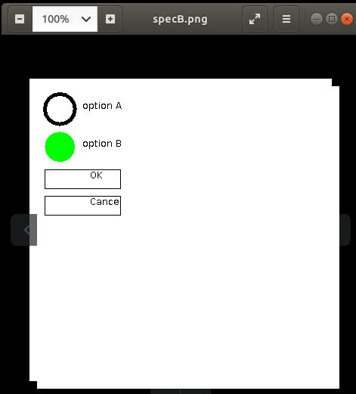
Render at host’s side
HDMI frames + overlay

Slide 22
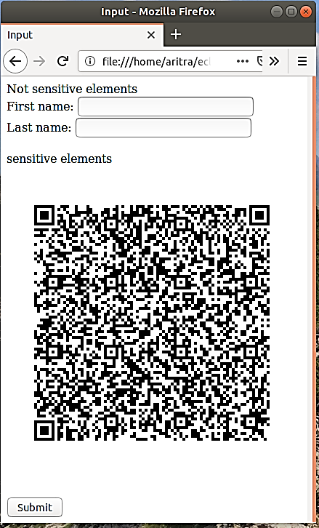
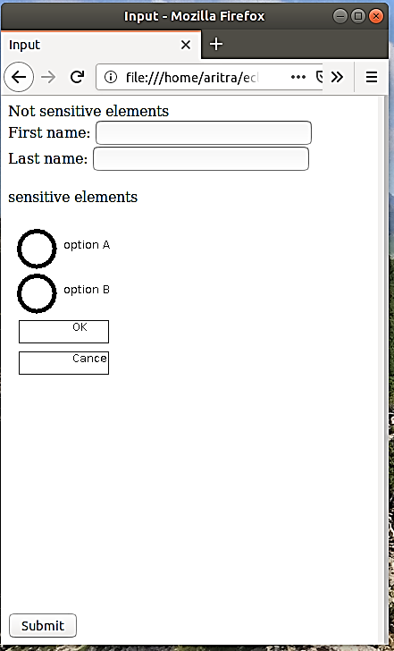
1
2
Host’s view
User’s view on the monitor

Slide 23
1
2
Host’s view
User’s view on the monitor

Slide 24
a
b
c
Attacker’s view
User’s view on the monitor
Focusing user’s attention

Slide 25
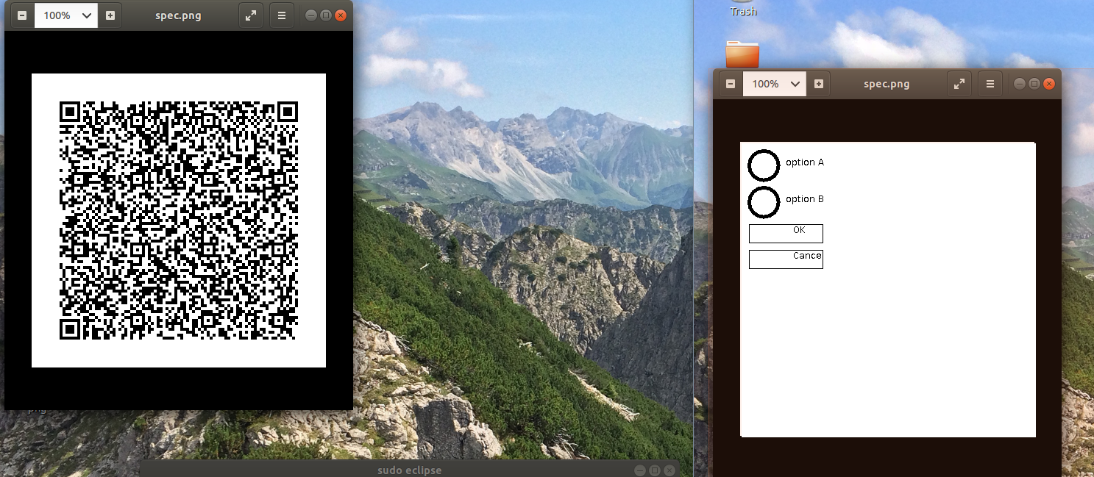
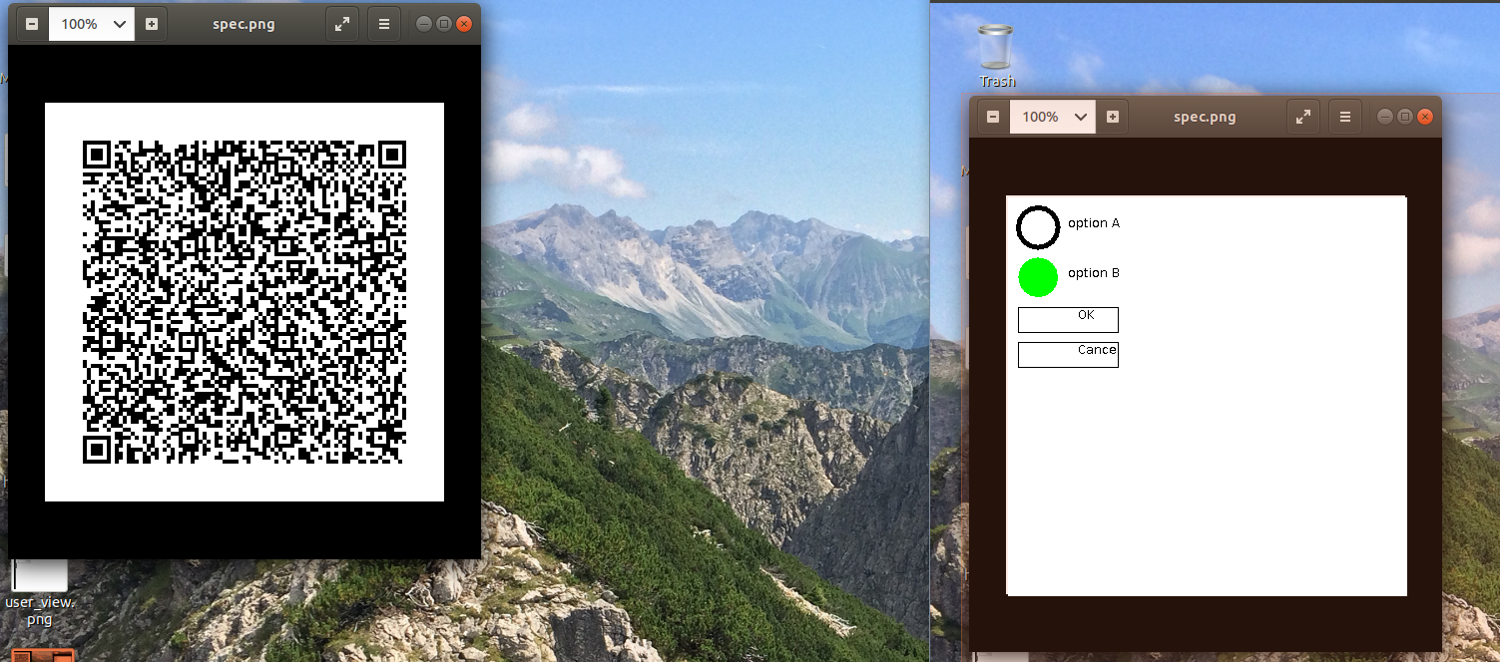
Render at host’s side
HDMI frames + overlay
1
Render at host’s side
Interaction on overlay
2

Slide 26
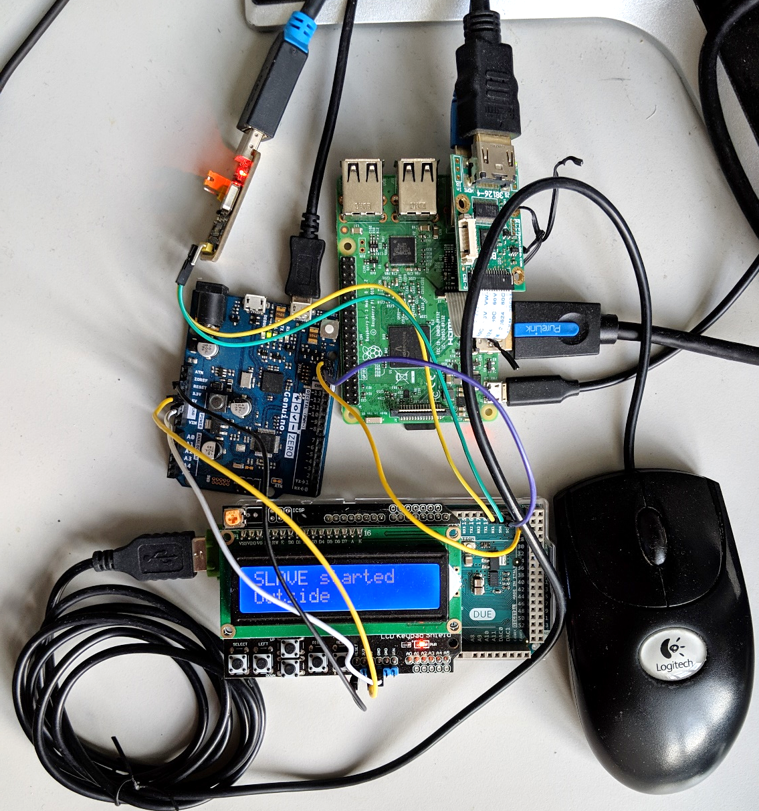
HDMI from host
HDMI to camera input

Slide 27
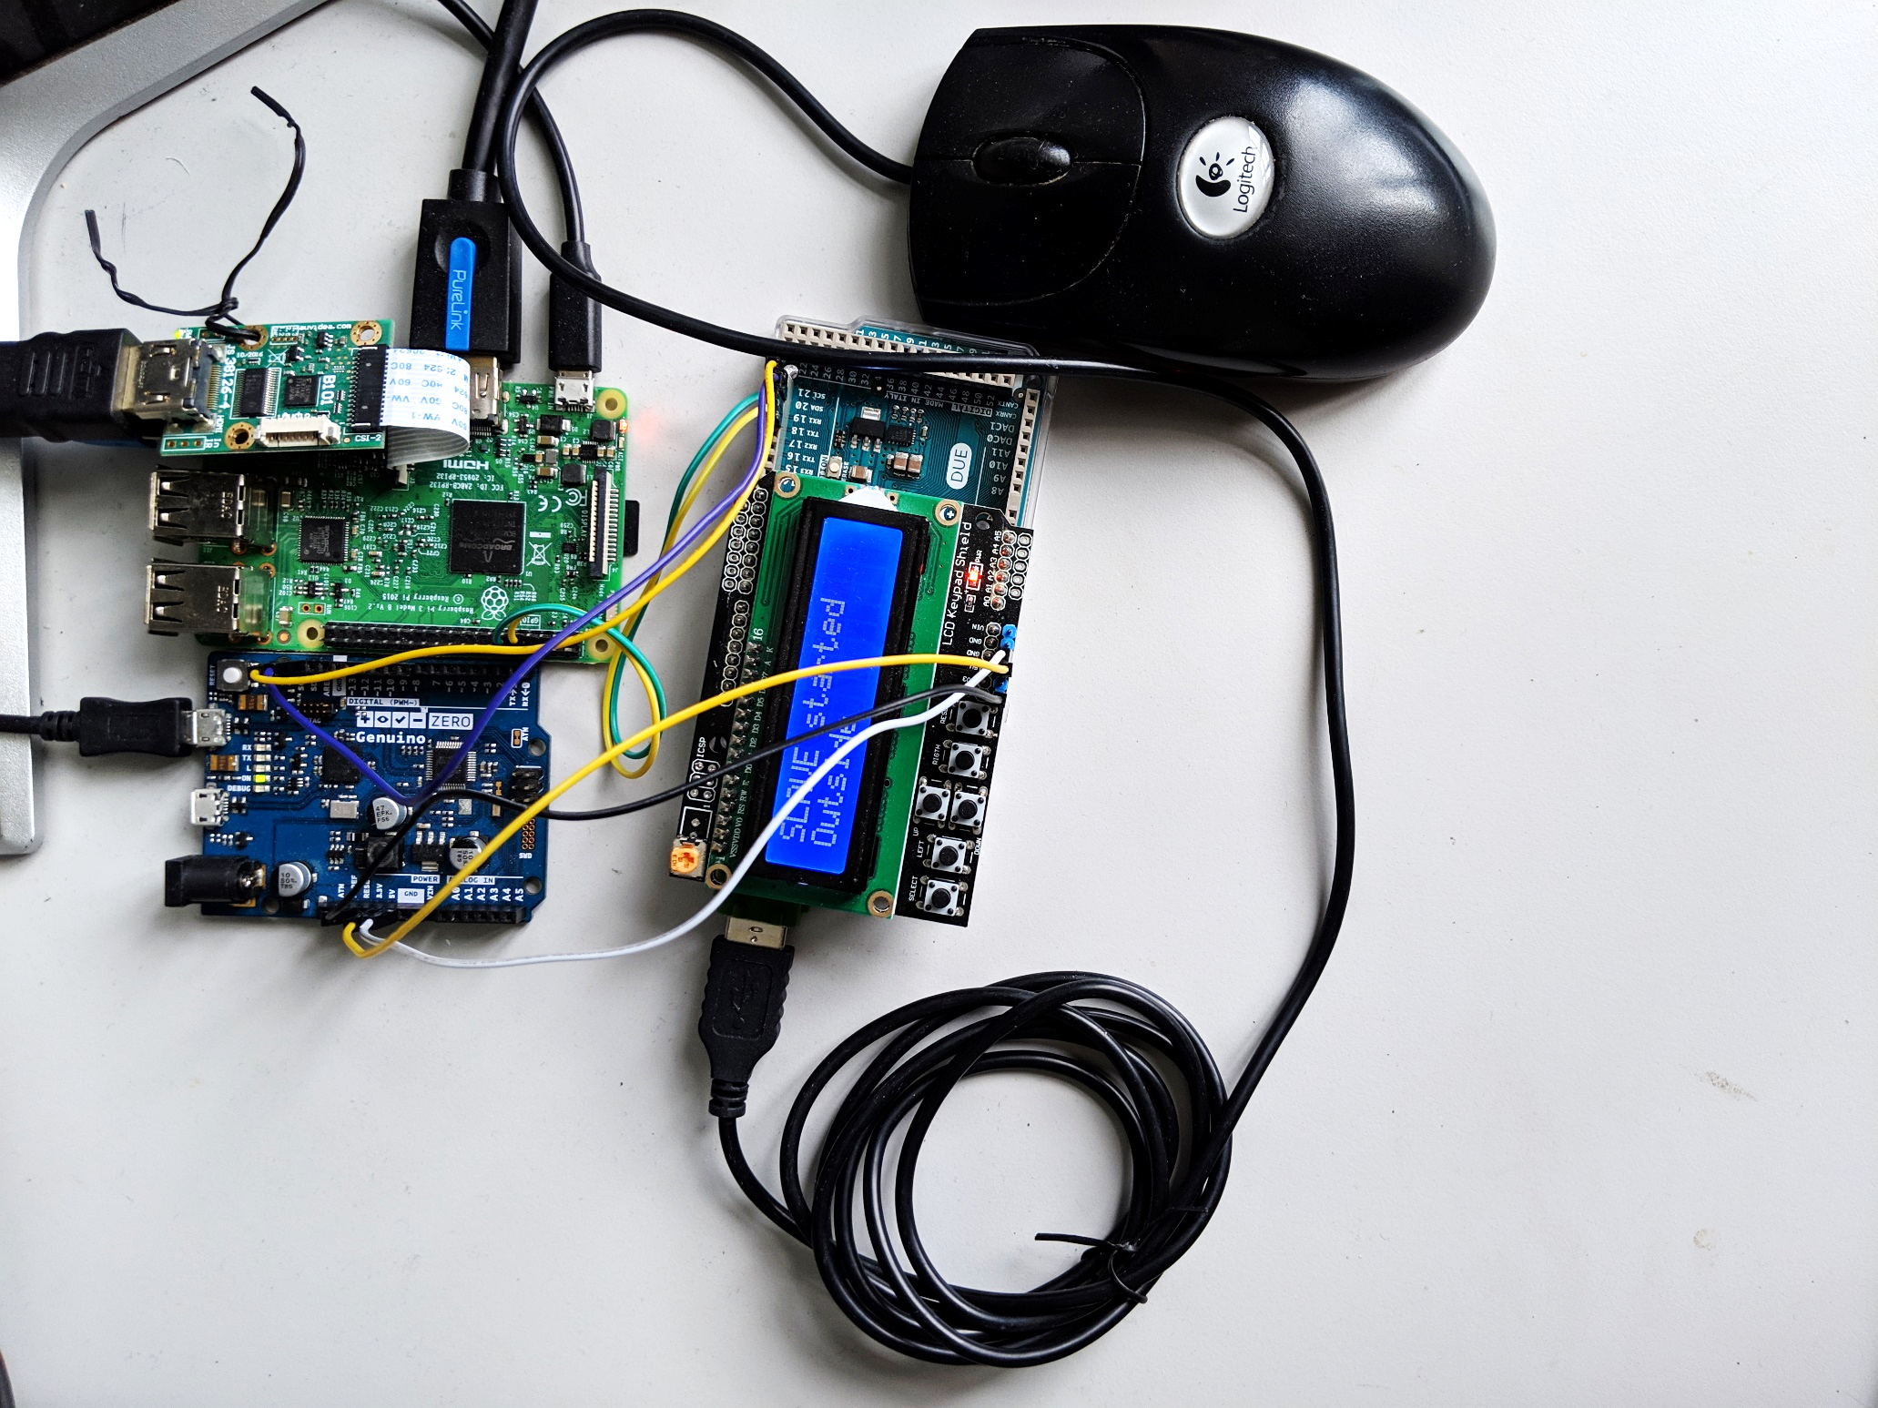
Rpi 3 for communication to host
HDMI from host
HDMI to camera input
Mouse/keyboard emulator
Mouse/keyboard interceptor and relay
HDMI to Display

Slide 28
5
8
4
6
7
9
2
3
1

Slide 29
1
9
7
3
8
6
5
4
2

Slide 30
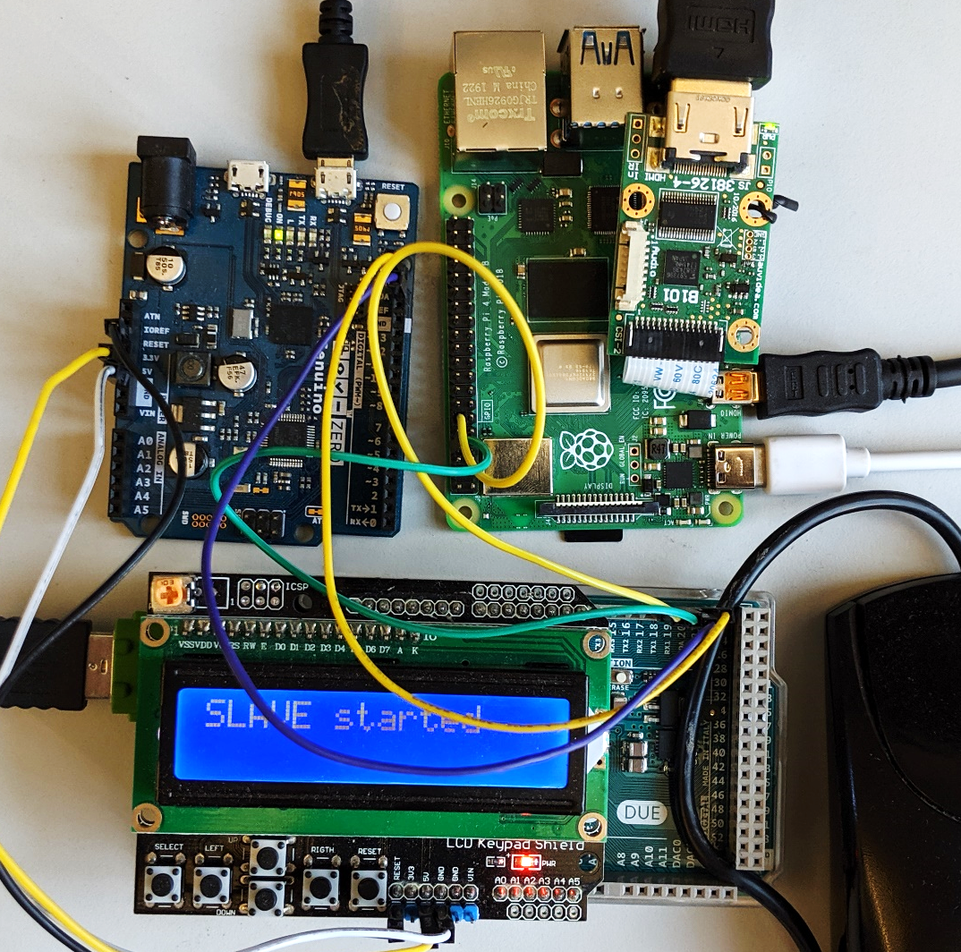
5
6
8
4
7
9
3
1
2
Notes:
Pi4

Slide 31
7
HDMI interceptor
HDMI out
8
Device
6
Raspberry pi 3
Host
9
Display
4
3
1
Arduino
Zero
Arduino
Due
Input device
USB in
5
2

Slide 32
Device
7
Raspberry pi 4
HDMI out
HDMI interceptor
6
Display
8
9
4
3
1
Arduino
Zero
Arduino
Due
Input device
USB in
5
2

Slide 33
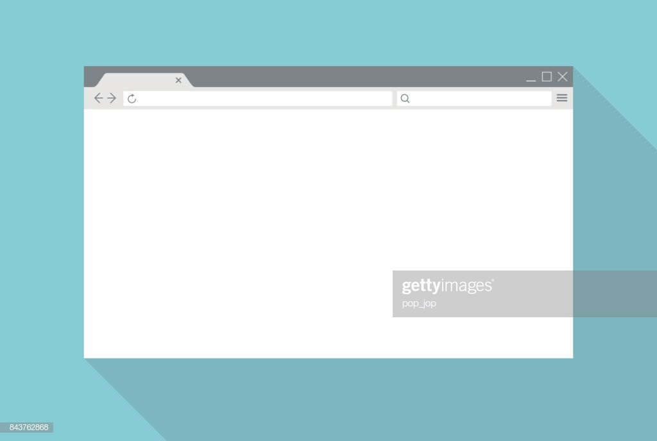
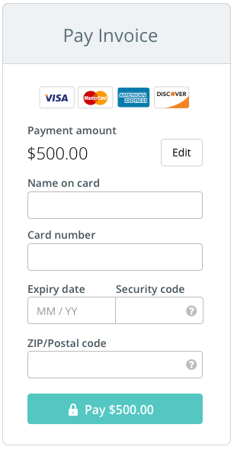
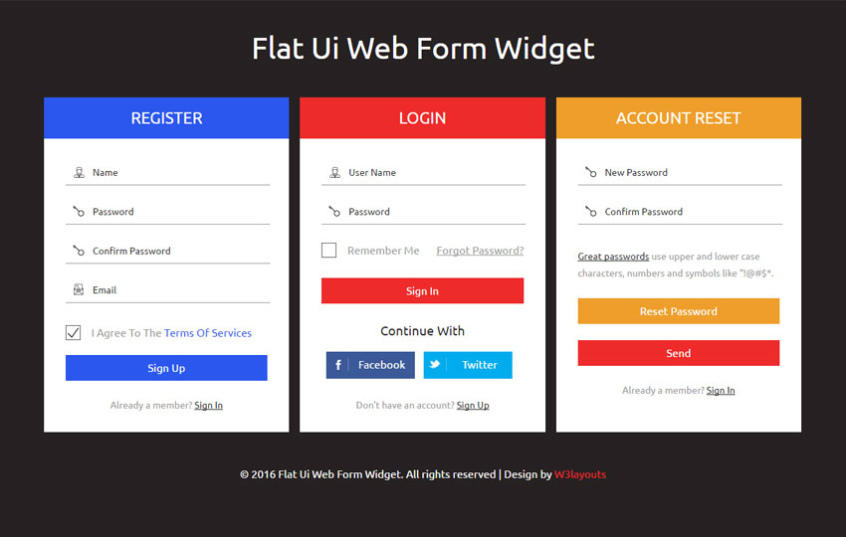
Early form submission
Jon Snow
Overlaid textfields
1111 1111 1111 1111
12/21
123
Fake cursor that user follows
1234
Real cursor

Slide 34
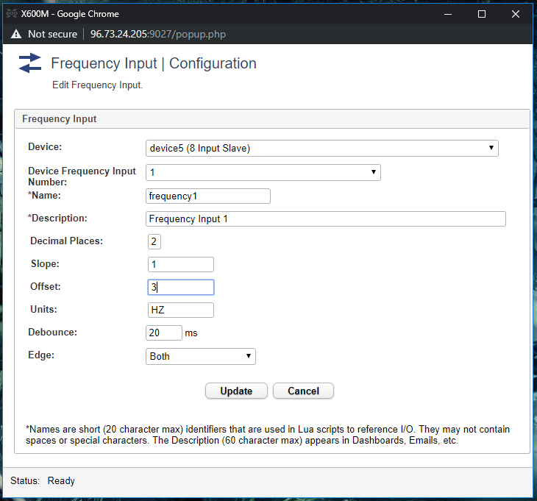
Textbox in focus
OS triggers click

Slide 35
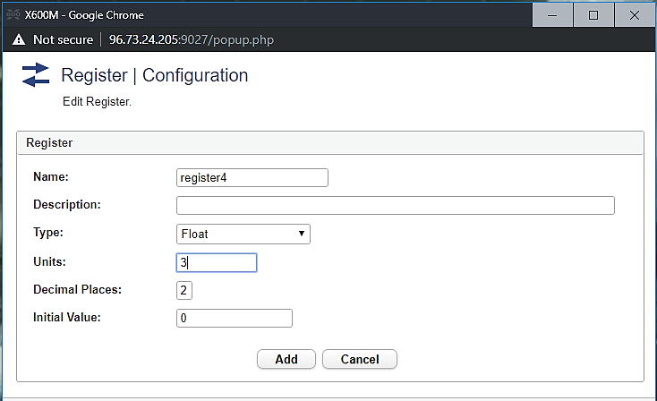
Textbox in focus
OS triggers click

Slide 36
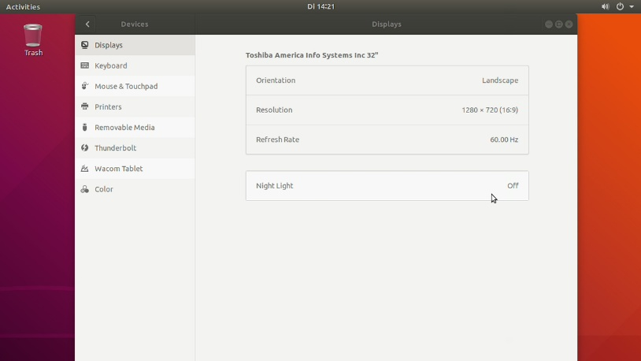
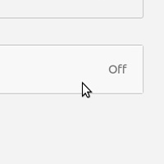
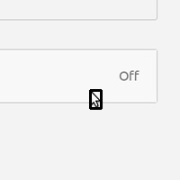
Cursor template
HDMI frame
Cropped frame
Detected cursor

